Slide 1
Abstract

Slide 2
Objectives
To reduce user time
To reduce people physical economic
To develop the apps information in Myanmar
To reduce the paper work
To understand the user about apps information without confusing

Slide 3
Introduction
Nowadays, everybody can use personal computer in their own life. As the improving of the network technology, people use computer with the internet. To save time and to reduce people’s physical effort, internet technology is more important in current people life

Slide 4
Introduction to Git, Github and Github Pages
Git, Github, and Github pages are all very closely related. Imagine Git as the workflow to get things done and Github and Github pages as places to store the work you finish. Projects that the use Git are stored publicy in Github and Github pages, so in a very generalized way, Git is what you do locally on your own computer and Github is the place where all this gets stored publicy on a server.

Slide 5
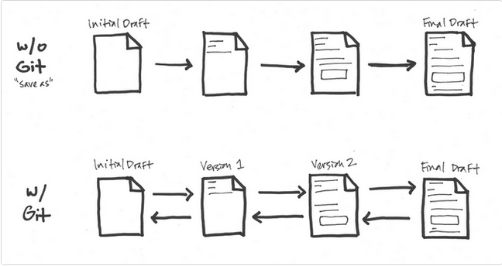
What is Git?
Git is a version control system that tracks changes to files in a project over time. It typically records what the changes, were ( what was added ? What was removed from the file?), who made the changes, notes and comments about the changes by the changer, and at what time the changes were made.
Git for people who want to maintain multiple versions of their files in an efficient manner and travel back in time to visit different versions without juggling numerous files along with their confusing names stored at different locations.
In the diagram below, each stage represents a “save”. Without Git, you cannot go back to any of the in between stages from the initial draft and final draft. If you wanted to change the opening paragraph in the final draft, you’d have to delete data that you couldn’t recover. To work around this, we use the “save a s” option, name it something different, delete the opening paragraph and writing a new one.

Slide 6
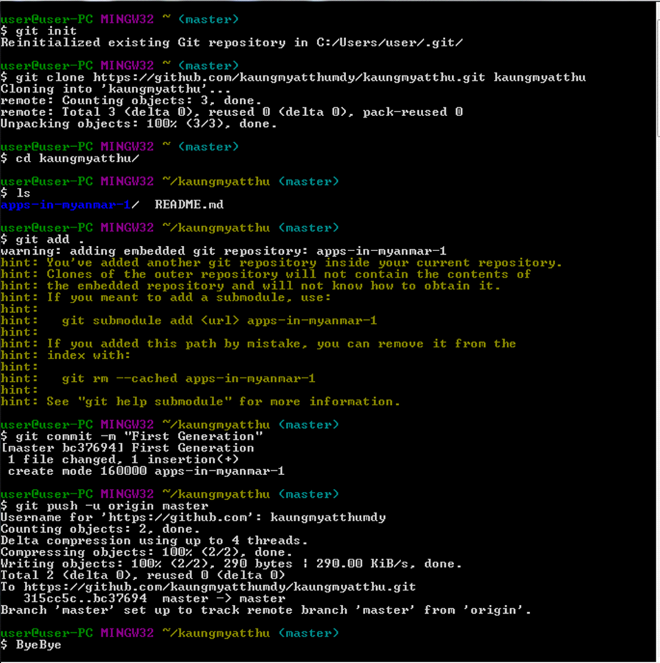
With Git, the flow is multidirectional. Each change that is significant is marked as important in a version, and you proceed. If you need to get back to earlier stages, you can without any loss of data. Presently, Google Docs “revision history” or Wikipedia’s “edit history” work in this sort of fashion. Git is just a lot more detailed and can get a lot more complex if needed.

Slide 7
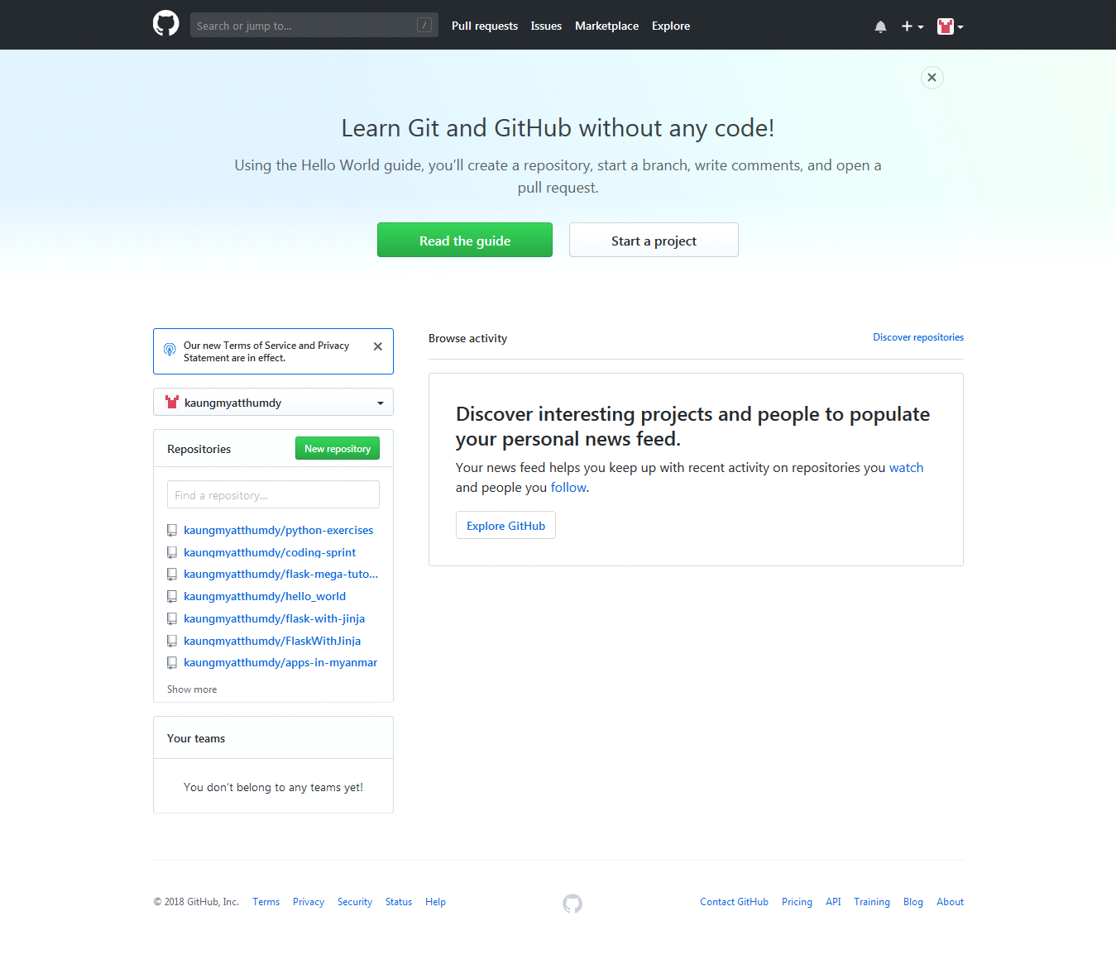
What is Github?
Github is a web hosting service for the source code of software and web development projects (or other text based projects) that use Git. In many cases, most of the code is publicly available, enabling developers to easily investigate, collaborate, download, use, improve, and remix that code. The container for the code of a specific project is called a repository.
Github is a code hosting platform for version control and collaboration. It let’s you and others work together on projects from anywhere.

Slide 8
What are the benefits of Github? Or What are the main benefits of using Github?
It makes it easy to contribute to your open source projects. To be honest, nearly every open-source project uses Github to manage their project.
It makes it easy to contribute to your open source projects
Documentation
Show case your work…
Markdown. Markdown allows you to use a simple text editor to write formatted documents.
Github is a repository…
Track changes in your code across versions…
Integration options.
Understanding the Github Flow
Link:
https://guides.github.com/introduction/flow/

Slide 9
What is Github page?
Github pages are public webpages hosted for free through Github. Github users can create and host both personal websites (one allowed per user) and websites related to specific Github projects. Pages let you do the same things as Github, but if the repository is named a certain way and files inside it are HTML or Markdown, you can view the file like any other website. Github pages is the self-aware version of Github. Pages also come with a powerful static site generator called Jekyll.
Github page is a static site hosting service designed to host your personal, organization, or project pages directly from a Github repository and doesn’t support server-side code such as PHP, or Python.
You can create and publish Github pages sites online using the Jeklly Theme Chooser. Or if you prefer to work locally, you can use Github Desktop or the command line.

Slide 10
User, Organization, and Project Pages
There are two basic types of Github pages sites: project pages sites, and user & organization pages sites. They are nearly identical but have some important differences.
Project pages sites are connected to a specific project, and the site files live on a branch within project repository.
User and organization pages sites are not tied to a specific project, and the site live in a special repository dedicated fo Github pages files.

Slide 11

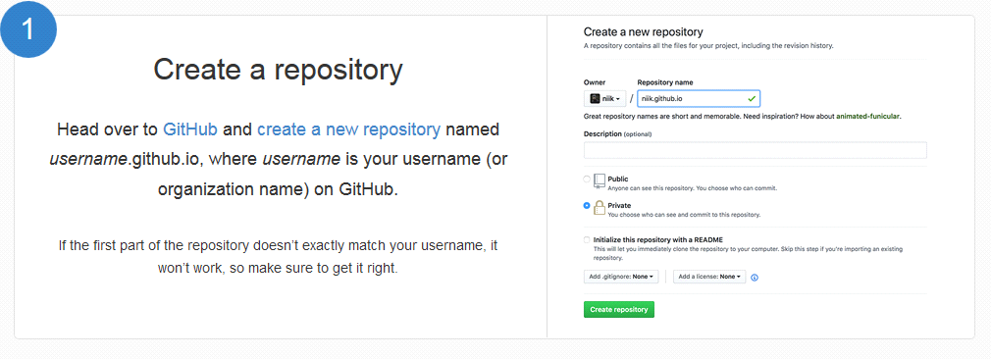
Building our own site from scratch or generate one for our project

Slide 12

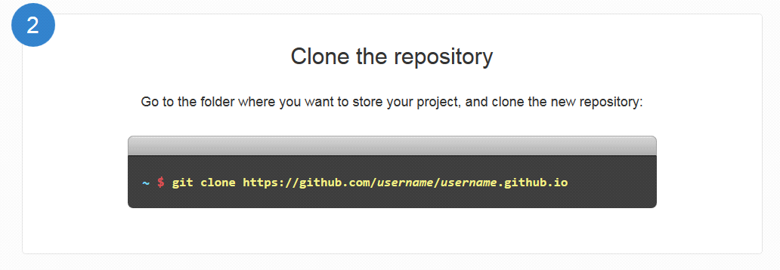
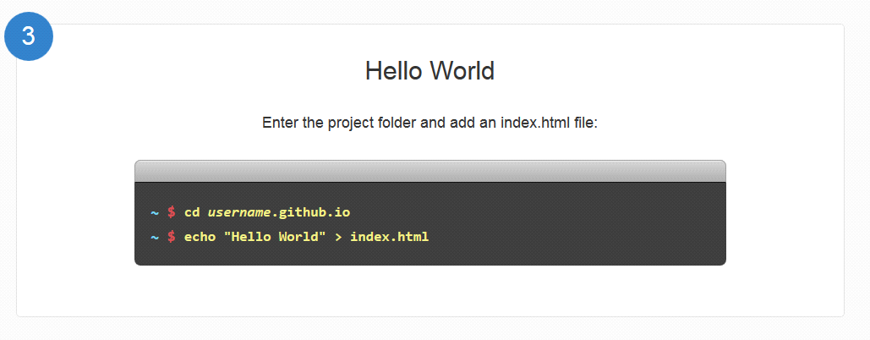

Slide 13
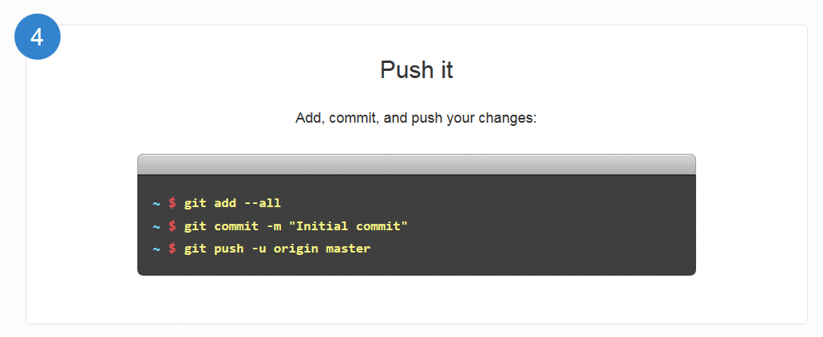
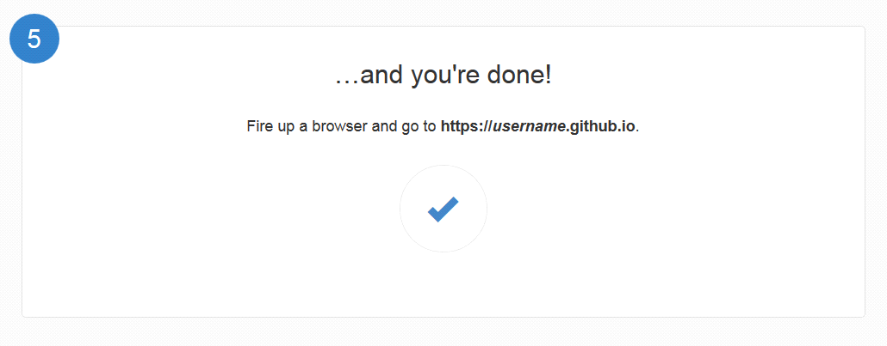

Slide 14

For example
https://kaungmyatthumdy.github.io
https://mohninyu.github.io
https://hlayaminhtike.github.io
https://khinhsumyatnoe.github.io
https://SuPoPoo.github.io
https://hanhtunaung.github.io
Figure: Personal Page

Slide 15
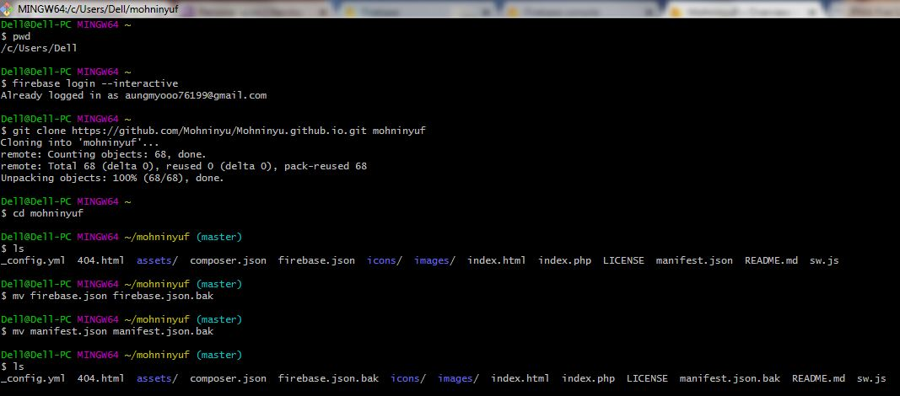
Figure: Firebase deploy that created above personal page
need to install at gitbash command $ npm install –g firebase-tools
$ firebase login --interactive
git clone to firebaseId

Slide 16
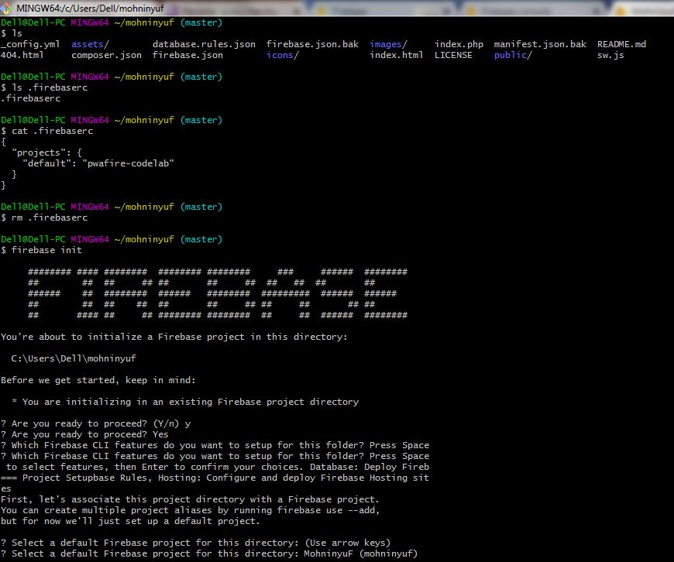
Figure: Firebase init

Slide 17
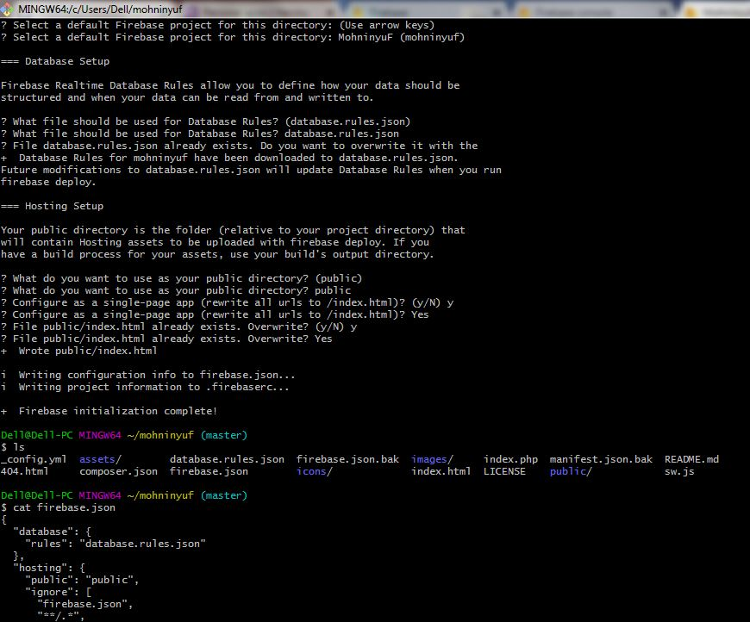

Slide 18
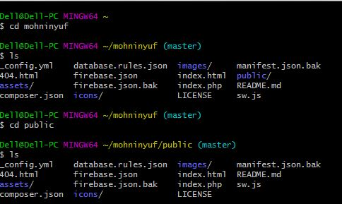
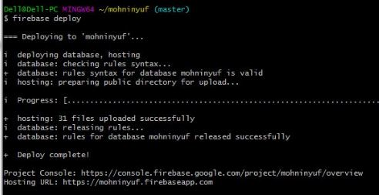
We need to copy index.html to public/index.html So, firebase can deploy
Figure: Personal Page with firebase deploy
https://mohninyuf.firebaseapp.com/

Slide 19
Firebase
Firebase Hosting is a static and dynamic web hosting service that launched on May 13, 2014. It supports hosting static files such as CSS, HTML, JAVASCRIPT, and other files as well as dynamic Note.js support through Cloud function.
Real time database, Storage, Authentication future for your user, you can also use cloud function for complicated logics in your app. Firebase is a back-end service that your app can interact with. It has a lot of features such as Real time database, User Authentication, file storage and much more.

Slide 20
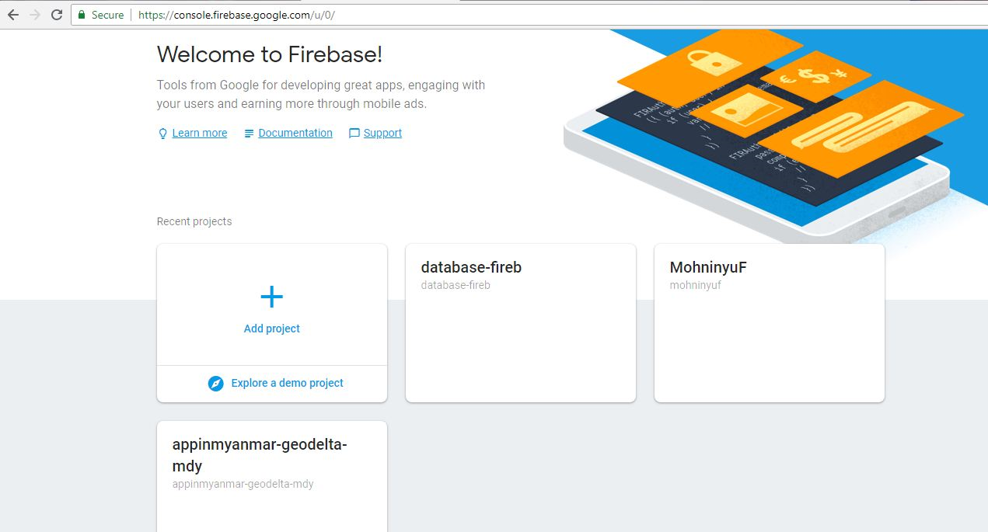
Figure: Firebase

Slide 21
Real Time Database
Firebase provides a realtime database and backend as a service. The service provides application developers an API that allows application data to be synchronized across clients and stored on Firebase's cloud..The company provides client libraries that enable integration with Android, iOS, JavaScript, Java, Objective-C, Swift and Node.js applications. The database is also accessible through a REST API and bindings for several JavaScript frameworks such as AngularJS, React, Ember.js and Backbone.js. The REST API uses the Server-Sent Events protocol, which is an API for creating HTTP connections for receiving push notifications from a server. Developers using the realtime database can secure their data by using the company's server-side-enforced security rules. Cloud Firestore which is Firebase's next generation of the Realtime Database was released for beta use.

Slide 22
Firebase Storage
Firebase Storage provides secure file uploads and downloads for Firebase apps, regardless of network quality. The developer can use it to store images, audio, video, or other user-generated content. Firebase Storage is backed by Google Cloud Storage.

Slide 23
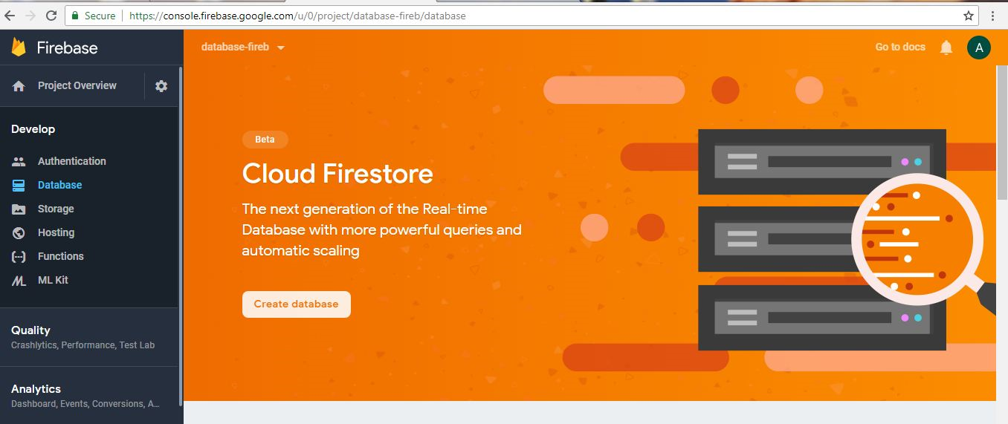
Figure: Example for Firebase By real-time database

Slide 24
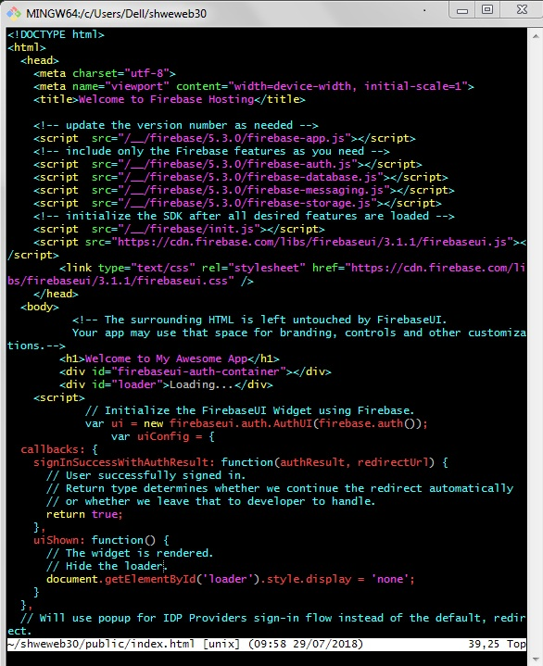
Figure: vim index.html

Slide 25
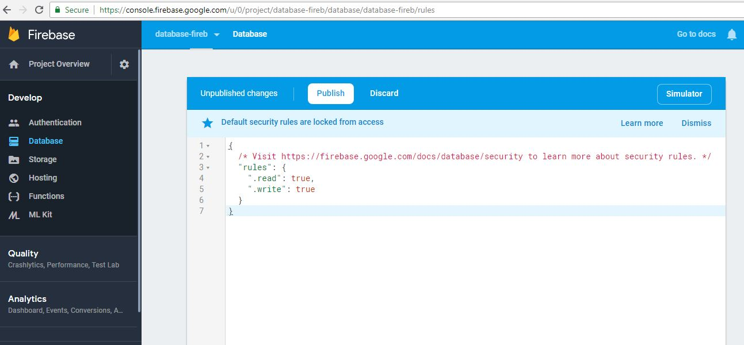
Figure: Default Security Rules are locked from access

Slide 26
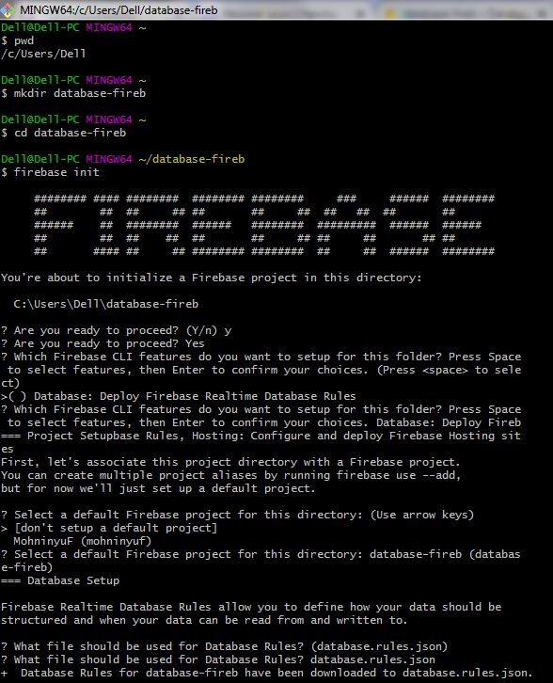
Figure: firebase init for Real Time Database

Slide 27
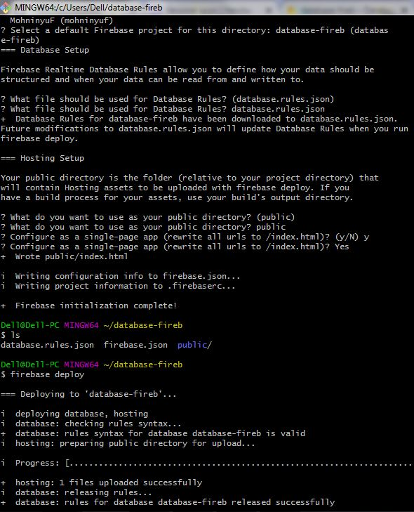
Figure: firebase deploy for Real Time Database

Slide 28
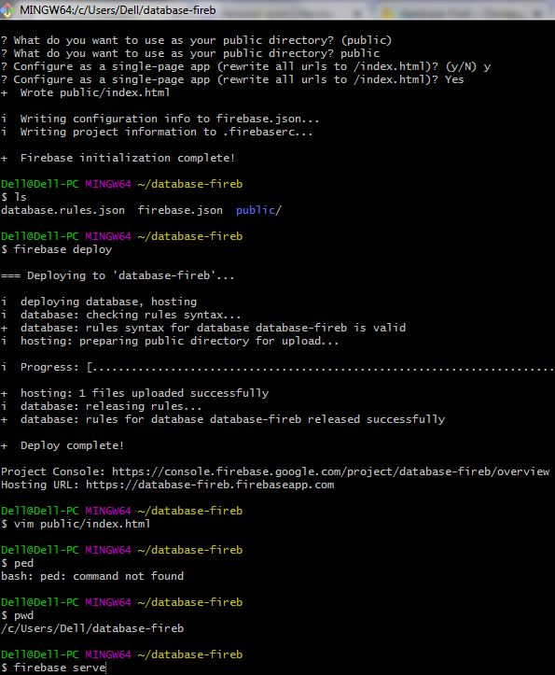
Figure: update index.html and firebase serve for Real Time Database

Slide 29
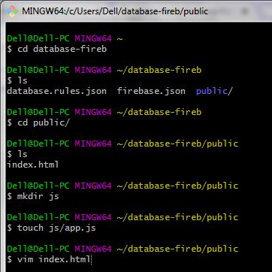
At second gitbash
Figure: create js/app.js for Real Time Database

Slide 30
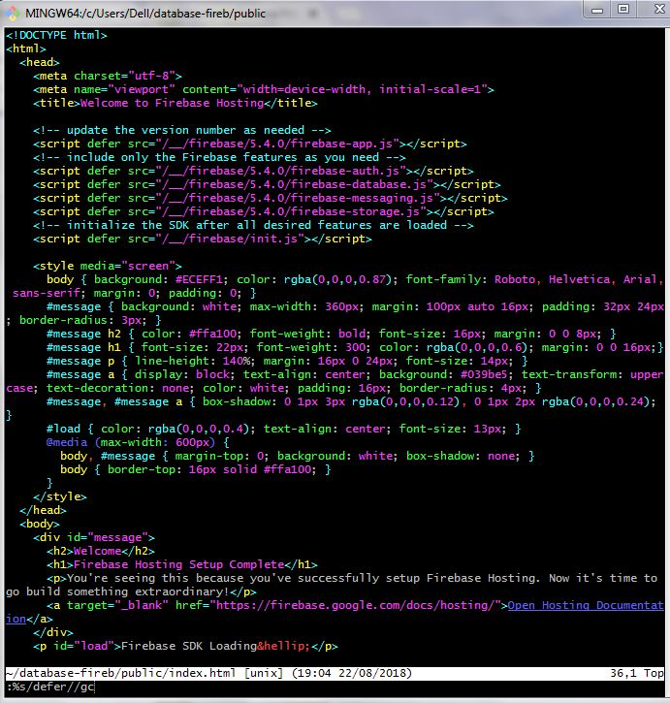
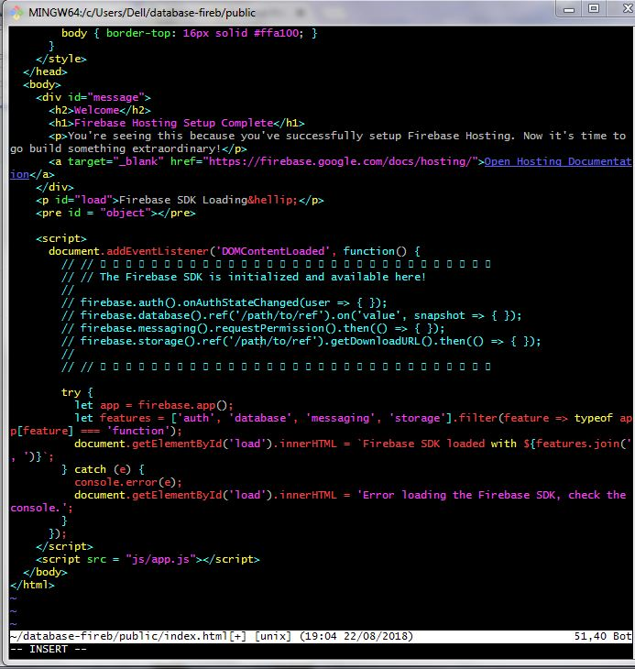
Figure: updated index.html

Slide 31
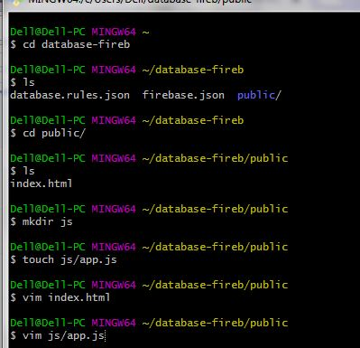
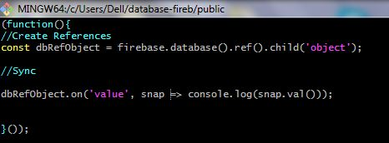
Figure: Creating Database Function

Slide 32
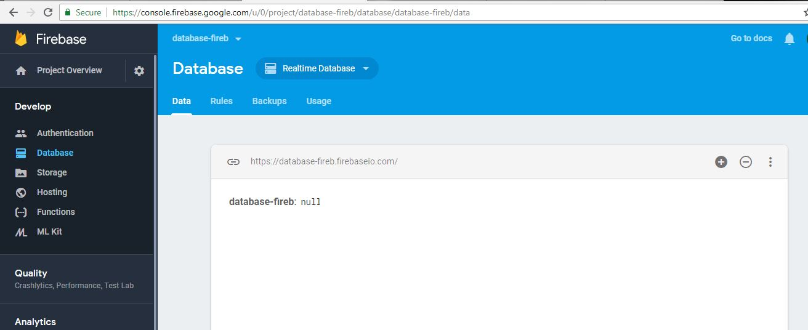
At real time database , null, and also localhost site, null Because of using “ .on “ value

Slide 33
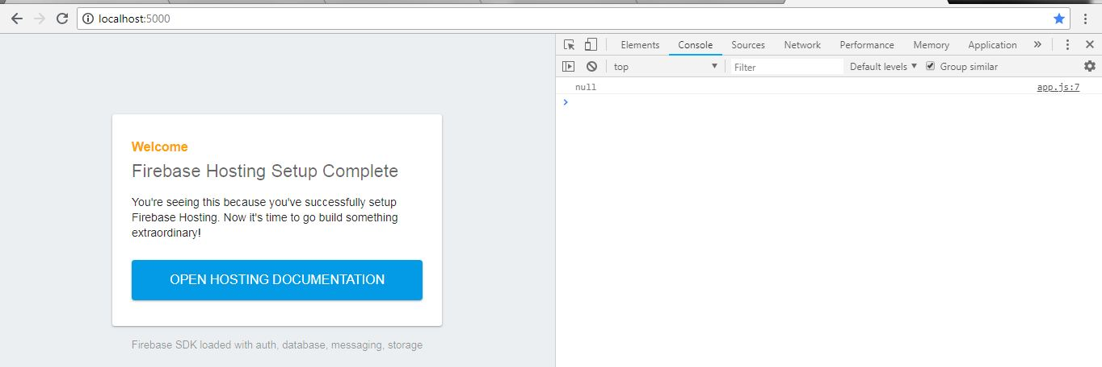
At real time database, null, and also at localhost site , null . Because of using “ .on “ value

Slide 34
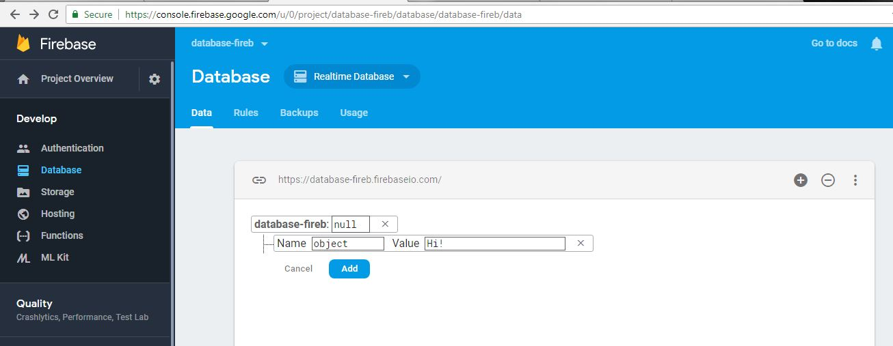
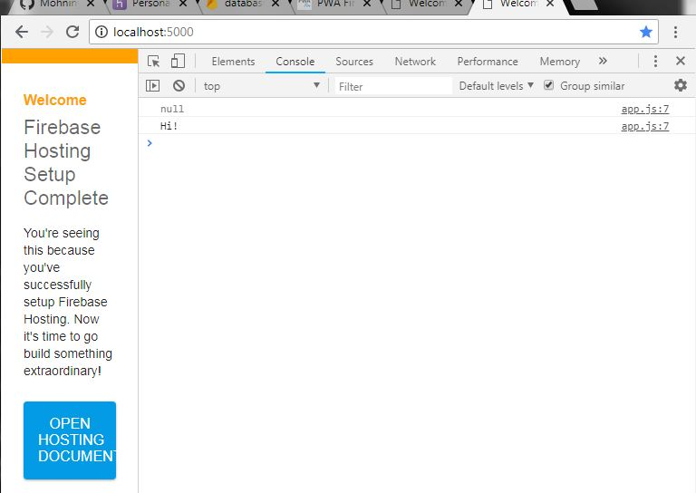

Slide 35
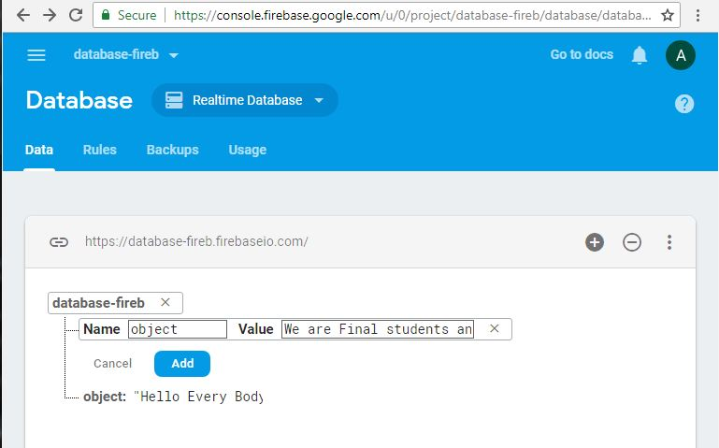
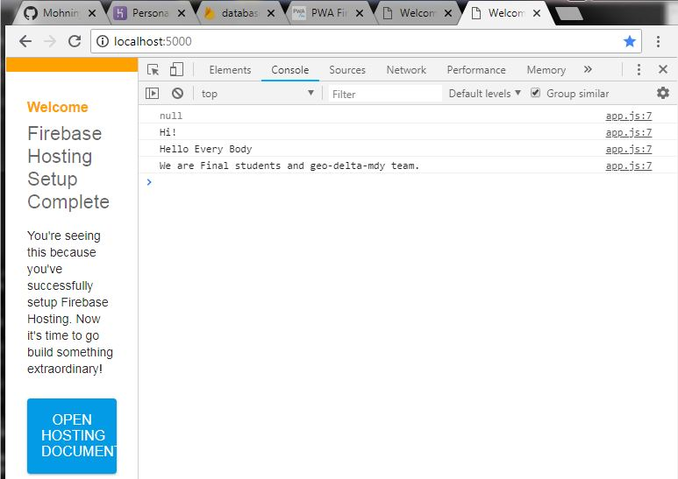

Slide 36
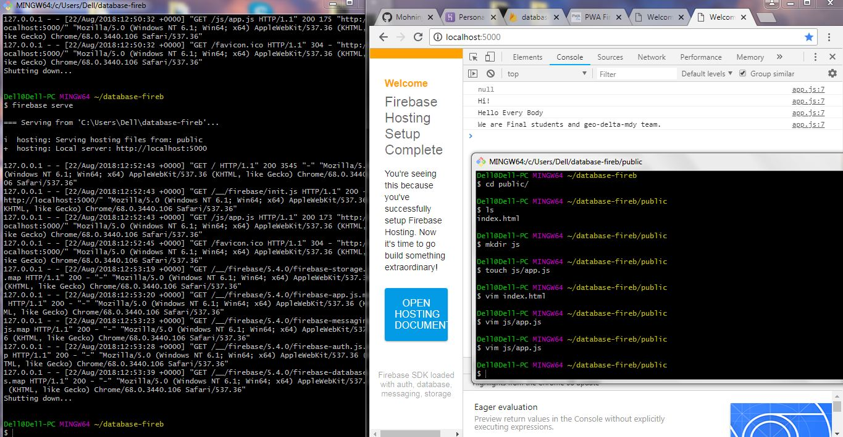

Slide 37
Firebase Authentication
Firebase Auth is a service that can authenticate users using only client-side code. It supports social login providers Facebook, GitHub, Twitter and Google (and Google Play Games). Additionally, it includes a user management system whereby developers can enable user authentication with email and password login stored with Firebase

Slide 38
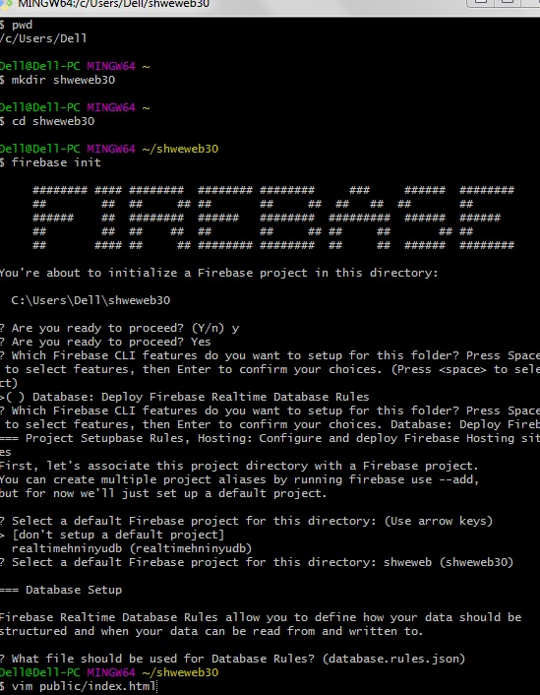
Figure: Example for Firebase By Authentication

Slide 39
Figure: updated index.html for Authentication

Slide 40
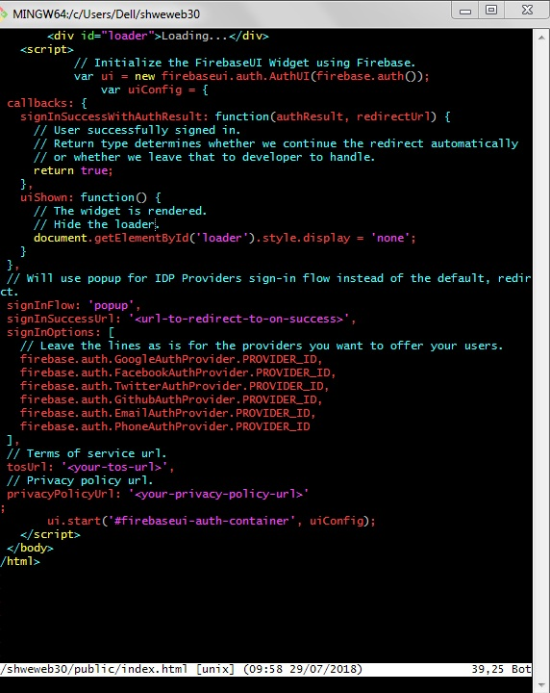
Figure: updated index.html for Authentication

Slide 41
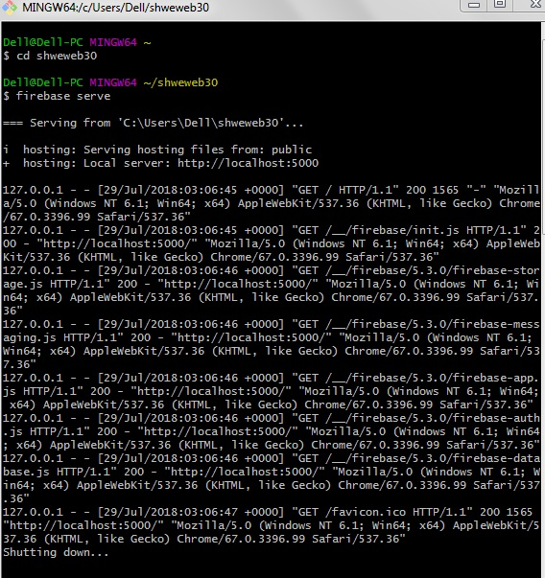
Figure: firebase serve for Authentication

Slide 42
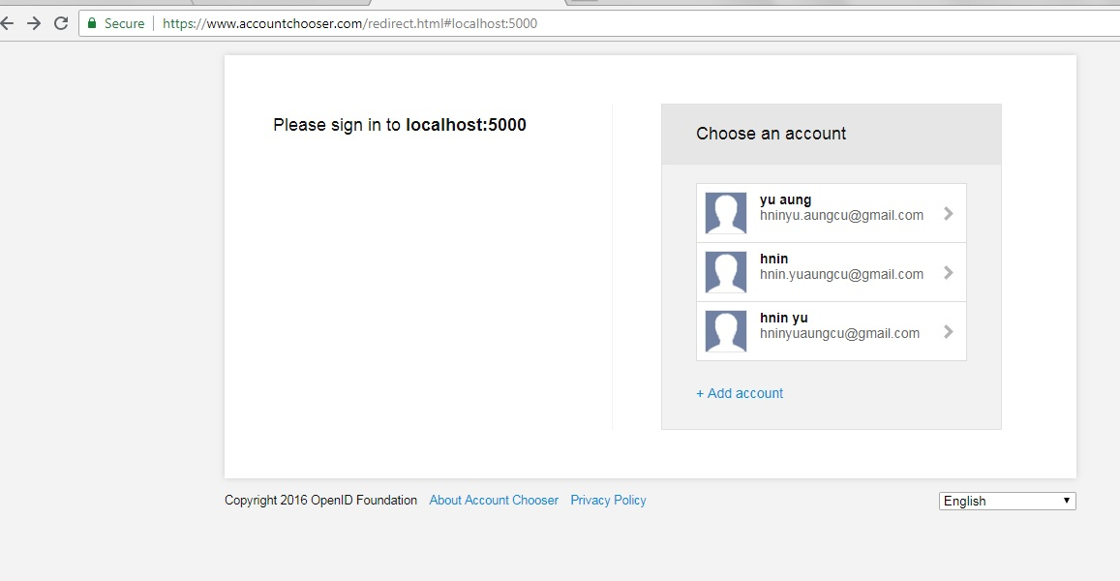
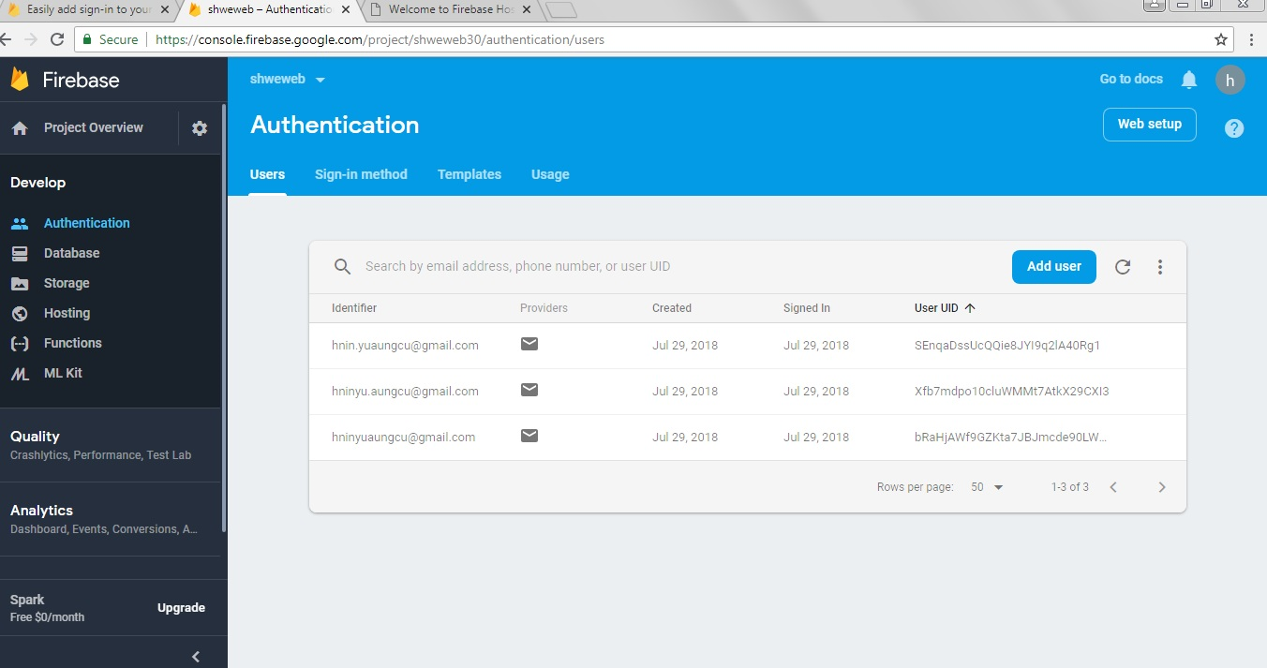

Slide 43
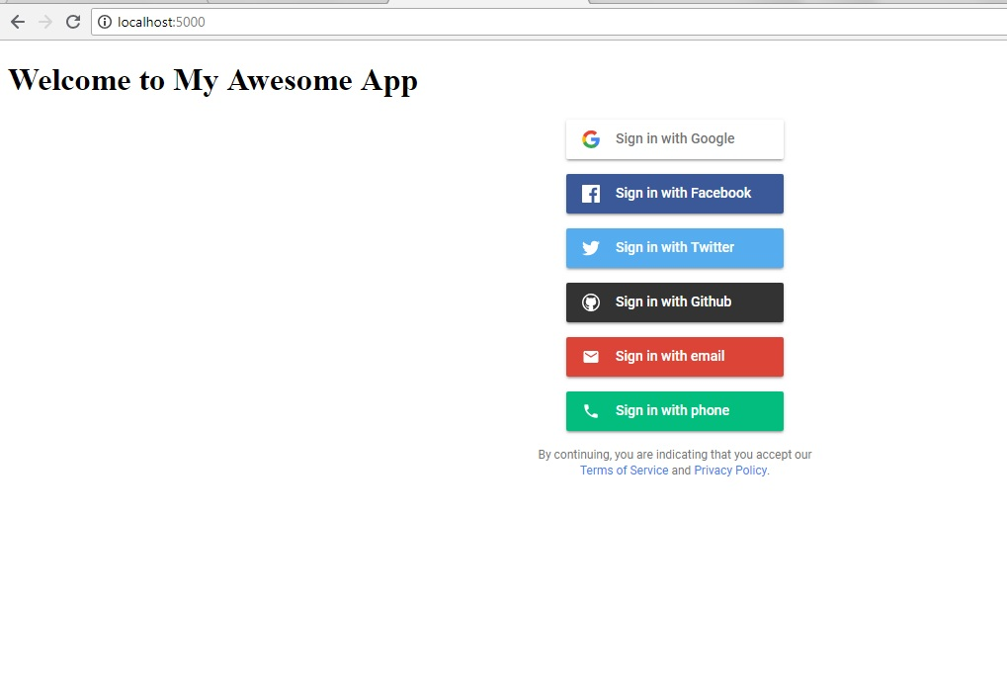
Figure: Example for Firebase By Authentication

Slide 44
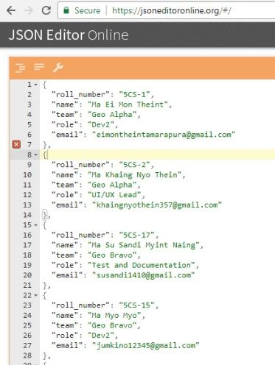

JSON Editor Online or Postman Need to download postman for API to test

Slide 45

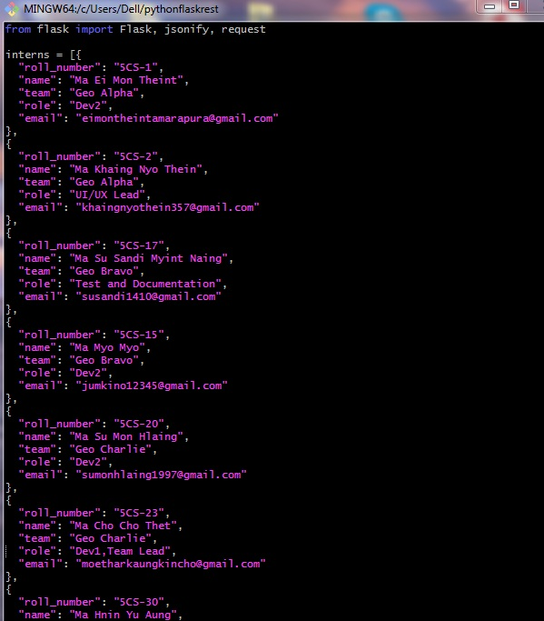
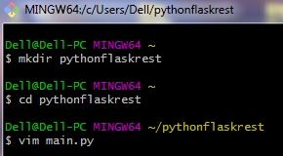

Slide 46
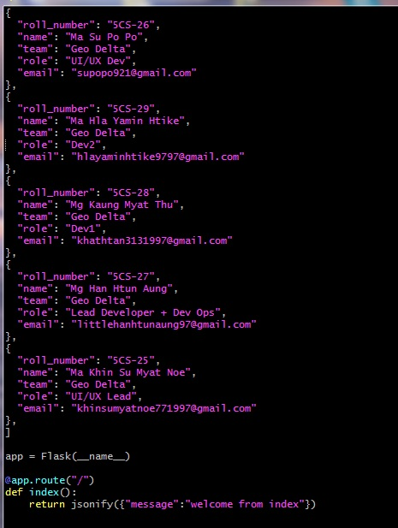

Slide 47
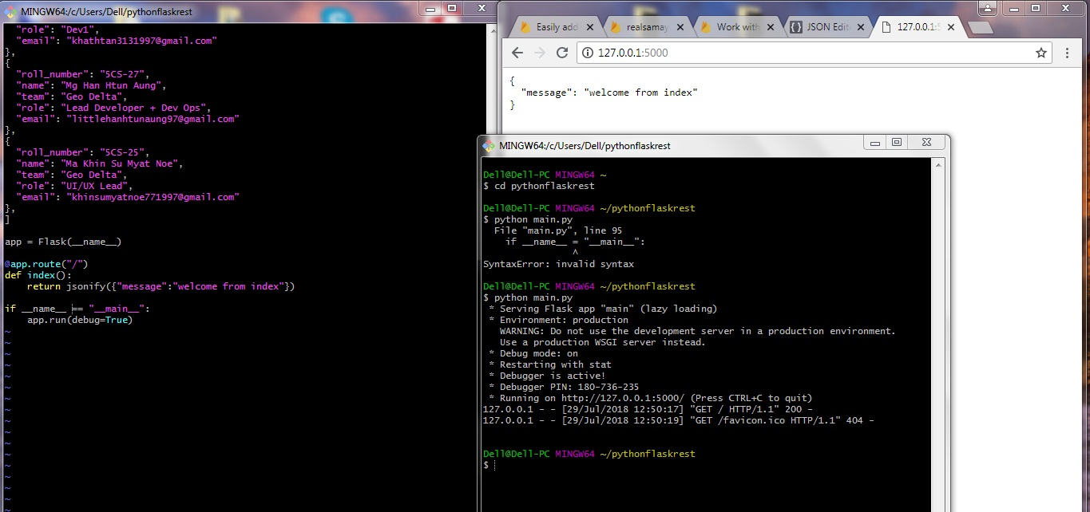

Slide 48
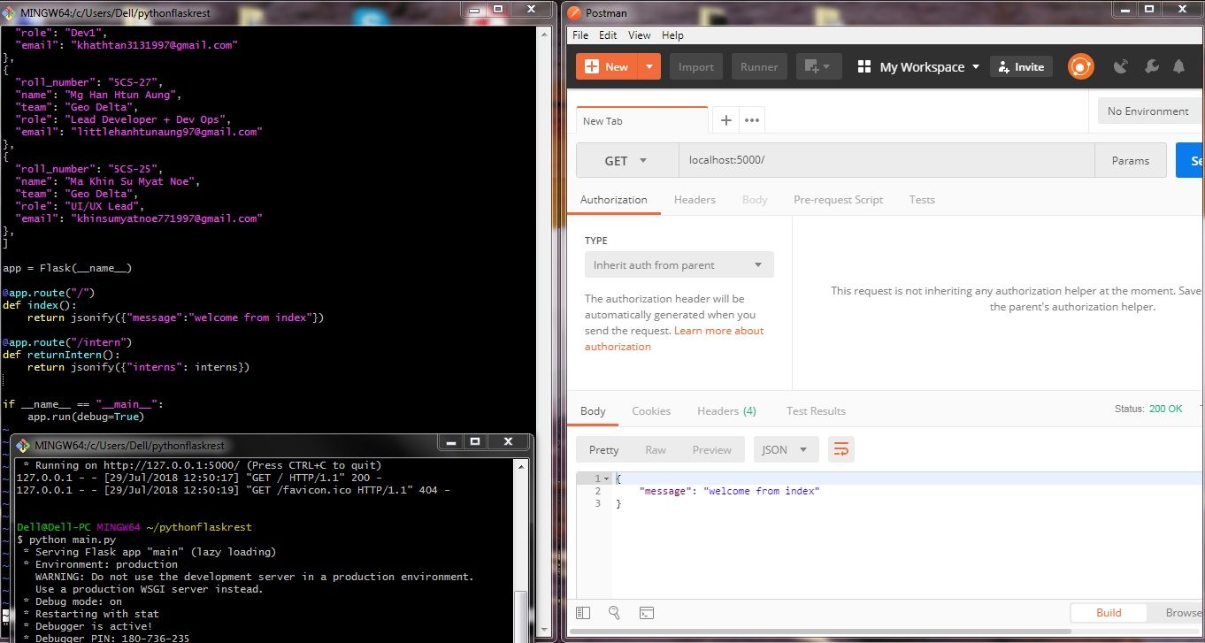

Slide 49
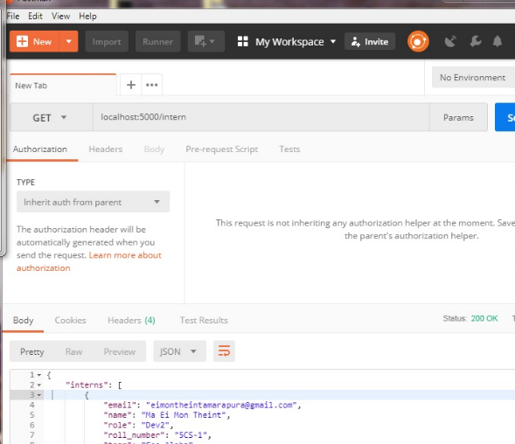

Slide 50
Background Theory
Cloud Firestore
Store and sync data between users and devices - at global scale - using a cloud-hosted, NoSQL database. Cloud Firestore gives you live synchronization and offline support along with efficient data queries. Its integration with other Firebase products enables you to build truly serverless apps.
Cloud Function
Extend your app with custom backend code without needing to manage and scale your own servers. Functions can be triggered by events, which are emitted by Firebase products, Google Cloud services.

Slide 52
Usecase Diagram for Apps in Myanmar

Slide 53
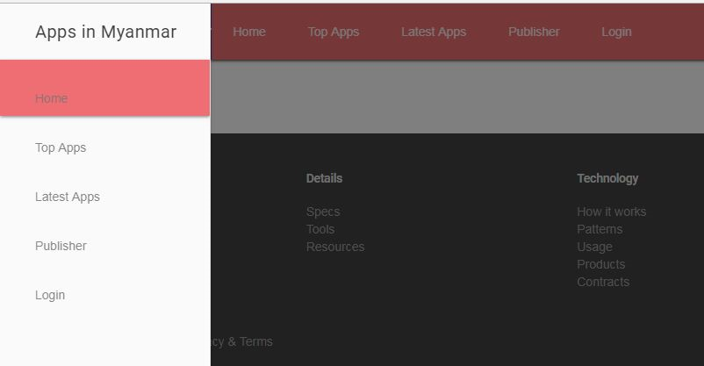
Implementation Figure: Home Page for Apps in Myanmar

Slide 54
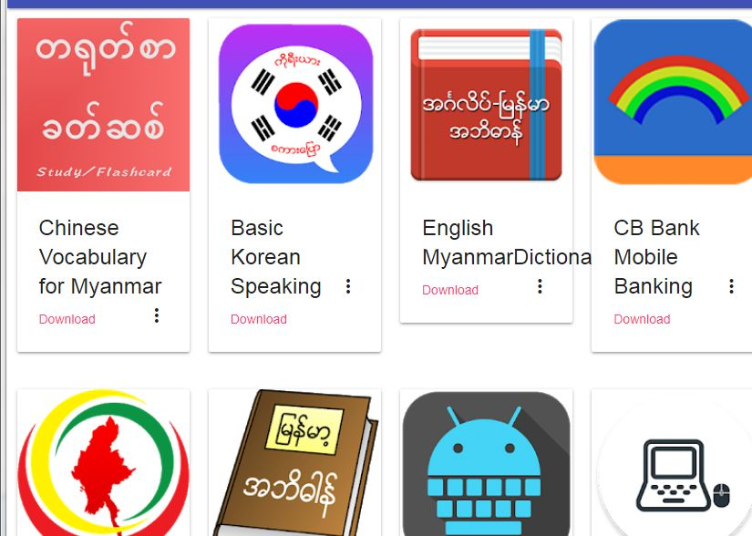
Figure: Home Page for Apps in Myanmar

Slide 55
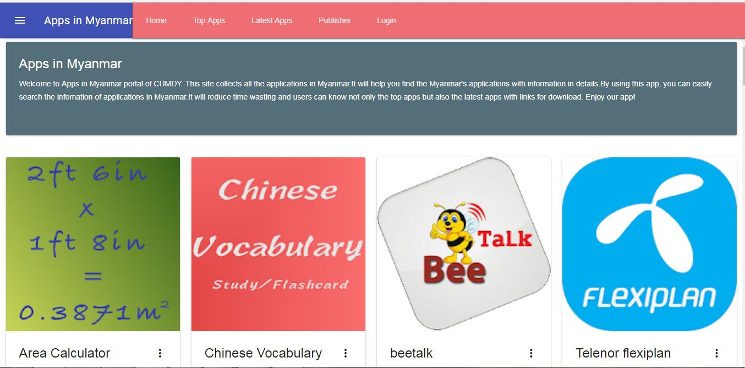
Figure: Home Page for Apps in Myanmar

Slide 56
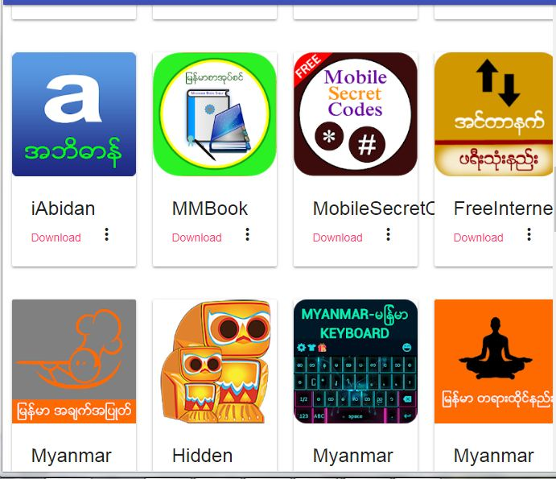
Figure: Home Page for Apps in Myanmar

Slide 57

Figure: Home Page for Apps in Myanmar

Slide 58
Figure: Home Page for Apps in Myanmar

Slide 59
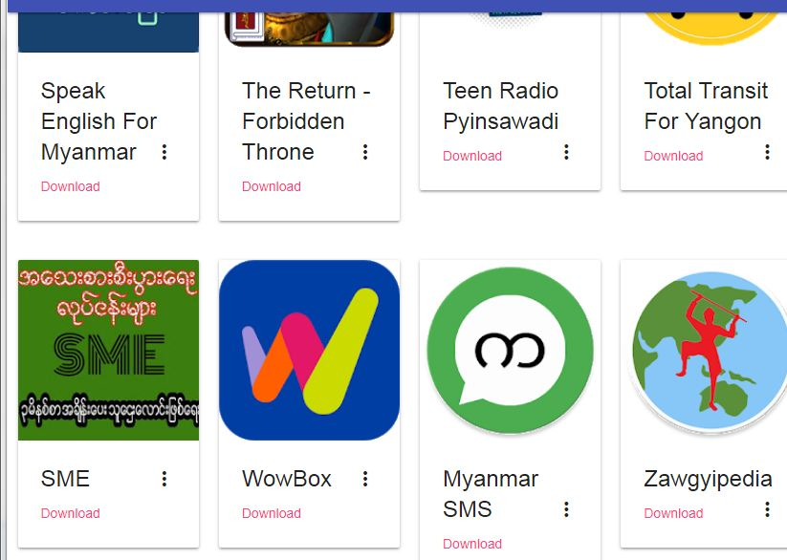
Figure: Home Page for Apps in Myanmar

Slide 60

Figure: Top Applications

Slide 61

Figure: Latest Application

Slide 62

Figure: Publisher

Slide 63


Figure: Login at Offline
Figure: Login with online

Slide 64

Figure: Login and Sign in

Slide 65

Figure: Footer

Slide 66

Figure: About Page

Slide 67

Figure: FAQ

Slide 68

Figure: Answers

Slide 69

Figure: Answers

Slide 70

Figure: Answers

